Slide 1
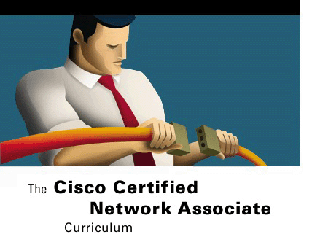



TCP/IP TRANSPORT and
APPLICATION LAYER
Networking Basics
Version 3.0
Cisco Regional Networking Academy

Slide 2
Objectives
Describe the functions of the TCP/IP transport layer.
Describe flow control.
Describe the processes of establishing a connection between peer systems.
Describe windowing.
Describe acknowledgment.
Identify and describe transport layer protocols.
Describe TCP and UDP header formats.
Describe TCP and UDP port numbers.
List the major protocols of the TCP/IP application layer.
Provide a brief description of the features and operation of well-known TCP/IP applications.

Slide 3
Table of Content
1 | TCP/IP Transport Layer
2 | TCP/IP Application Layer

Slide 4

TCP/IP TRANSPORT LAYER

Slide 5
Introduction to transport layer
The primary duties of the transport layer are to transport and regulate the flow of information from the source to the destination, reliably and accurately.
The transport layer defines end-to-end connectivity between host applications
Transport services include the following basic services:
  Segmentation of upper-layer application data
  Establishment of end-to-end operations
  Transport of segments from one end host to another end host
  Flow control provided by sliding windows
  Reliability provided by sequence numbers and acknowledgments
Notes:
The primary duties of the transport layer, Layer 4 of the OSI model, are to transport and regulate the flow of information from the source to the destination, reliably and accurately. End-to-end control and reliability are provided by sliding windows, sequencing numbers, and acknowledgments
To understand reliability and flow control, think of someone who studies a foreign language for one year and then they visit the country where that language is used. In conversation, words must be repeated for reliability and to speak slowly so that the meaning of the conversation is not lost, this is flow control.
The transport layer provides transport services from the source host to the destination host. It establishes a logical connection between the endpoints of the network. Transport services segment and reassemble several upper-layer applications onto the same transport layer data stream. This transport layer data stream provides end-to-end transport services.
The transport layer data stream is a logical connection between the endpoints of a network. Its primary duties are to transport and regulate the flow of information from source to destination reliably and accurately. The primary duty of Layer 4 is to provide end-to-end control using sliding windows and to provide reliability in sequencing numbers and acknowledgments. The transport layer defines end-to-end connectivity between host applications. Transport services include the following basic services:
Segmentation of upper-layer application data
Establishment of end-to-end operations
Transport of segments from one end host to another end host
Flow control provided by sliding windows
Reliability provided by sequence numbers and acknowledgments
TCP/IP is a combination of two individual protocols. IP operates at Layer 3, and is a connectionless protocol that provides best-effort delivery across a network. TCP operates at Layer 4, and is a connection-oriented service that provides flow control as well as reliability. By pairing these protocols, a wider range of services is provided. Together, they are the basis for an entire suite of protocols called the TCP/IP protocol suite. The Internet is built upon this TCP/IP protocol suite.

Slide 6
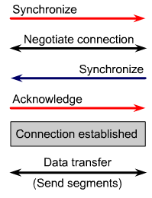
Session establishment, maintenance, and termination overview
One function of the transport layer is to establish a connection-oriented session between similar devices at the application layer.
Receiver
Sender

Slide 7
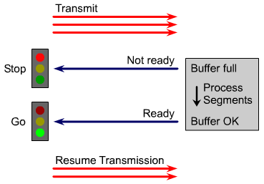
Flow control
Receiver
Sender
Notes:
Congestion can occur during data transfer for two reasons. First, a high-speed computer might be capable of generating traffic faster than a network can transfer it. Second, if many computers simultaneously need to send datagrams to a single destination, that destination can experience congestion, although no single source caused the problem.
When datagrams arrive too quickly for a host or gateway to process, they are temporarily stored in memory. If the traffic continues, the host or gateway eventually exhausts its memory and must discard additional datagrams that arrive.
Instead of allowing data to be lost, the transport function can issue a “not ready” indicator to the sender. Acting like a stop sign, this indicator signals the sender to stop sending data. When the receiver can handle additional data, the receiver sends a “ready” transport indicator. When this indicator is received, the sender can resume the segment transmission.
At the end of data transfer, the sending host sends a signal that indicates the end of the transmission. The receiving host at the end of the data sequence acknowledges the end of transmission and the connection is terminated.

Slide 8
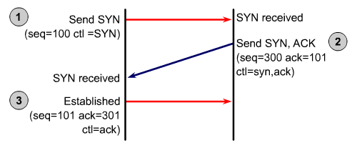
TCP: Three way handshaking
A
B
Notes:
TCP is a connection-oriented protocol. TCP requires connection establishment before data transfer begins. For a connection to be established or initialized, the two hosts must synchronize their Initial Sequence Numbers (ISNs). Synchronization is done through an exchange of connection establishing segments that carry a control bit called SYN, for synchronize, and the ISNs. Segments that carry the SYN bit are also called “SYNs". This solution requires a suitable mechanism for picking an initial sequence number and a slightly involved handshake to exchange the ISNs. The synchronization requires each side to send its own initial sequence number and to receive a confirmation of exchange in an acknowledgment (ACK) from the other side. Each side must also receive the INS from the other side and send a confirming ACK. The sequence is as follows:
A→B SYN—(A) initial sequence number is X, ACK number is 0, SYN bit is set, but ACK bit is not set.
B→A ACK—(A) sequence number is X + 1, (B) initial sequence number is Y, and SYN and ACK bit are set.
A→B ACK—(B) sequence number is Y + 1, (A) sequence number is X + 1, the ACK bit is set, but the SYN bit is not set.
This exchange is called the three-way handshake.
A three-way handshake is necessary because sequence numbers are not tied to a global clock in the network and TCP protocols may have different mechanisms for picking the ISN. The receiver of the first SYN has no way of knowing whether the segment was an old delayed one, unless it remembers the last sequence number used on the connection. Recalling that number is not always possible Therefore, the receiver must ask the sender to verify this SYN.

Slide 9
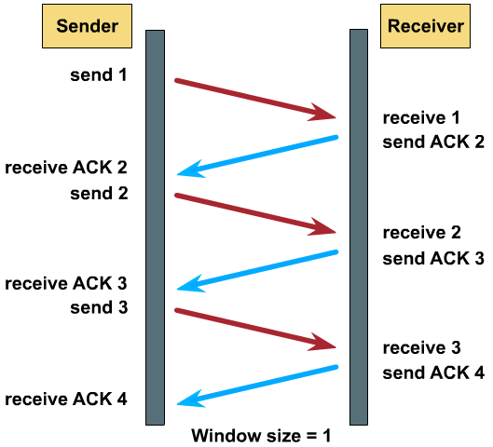
TCP: Window and Acknowledgment
Notes:
Data packets must be delivered to the recipient in the same order in which they were transmitted to have a reliable, connection-oriented data transfer. The protocol fails if any data packets are lost, damaged, duplicated, or received in a different order. An easy solution is to have a recipient acknowledge the receipt of each packet before the next packet is sent.
If the sender must wait for an acknowledgment after sending each packet, throughput would be low. Therefore, most connection-oriented, reliable protocols allow more than one packet to be outstanding on the network at one time. Because time is available after the sender finishes transmitting the data packet and before the sender finishes processing any received acknowledgment, this interval is used for transmitting more data. The number of data packets the sender is allowed to have outstanding without having received an acknowledgment is known as the window size,orwindow.
TCP uses expectational acknowledgments. Expectational acknowledgements mean that the acknowledgment number refers to the packet that is next expected. Windowing refers to the fact that the window size is negotiated dynamically during the TCP session. Windowing is a flow-control mechanism. Windowing requires that the source device receive an acknowledgment from the destination after transmitting a certain amount of data. The receiving TCP process reports a “window” to the sending TCP. This window specifies the number of packets, starting with the acknowledgment number, that the receiving TCP process is currently prepared to receive.
With a window size of three, the source device can send three packets to the destination. The source device must then wait for an acknowledgment. If the destination receives the three packets, it sends an acknowledgment to the source device, which can now transmit three more packets. If the destination does not receive the three packets, because of overflowing buffers, it does not send an acknowledgment. Because the source does not receive an acknowledgment, it knows that the packets should be retransmitted, and that the transmission rate should be slowed.

Slide 10
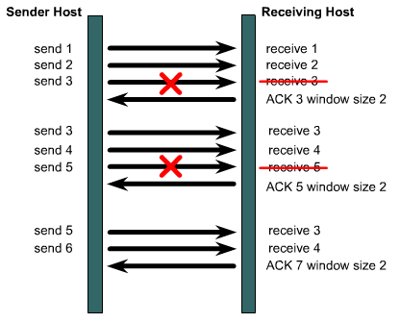
TCP: Sliding window and Acknowledgment
Notes:
TCP window sizes are variable during the lifetime of a connection. Each acknowledgement contains a window advertisement that indicates the number of bytes the receiver can accept. TCP also maintains a congestion-control window. This window is normally the same size as the window of the receiver. However, this window is cut in half when a packet is lost, perhaps as a result of network congestion. This approach permits the window to be expanded or contracted as necessary to manage buffer space and processing. A larger window size allows more data to be processed.
As shown in Figure , the sender sends three packets before expecting an ACK. If the receiver can handle a window size of only two packets, the window drops packet three, specifies three as the next packet, and specifies a new window size of two. The sender sends the next two packets, but still specifies a window size of three. This means that the sender will still expect a three packet acknowledgement from the receiver. The receiver replies by requesting packet five and again specifying a window size of two.

Slide 11
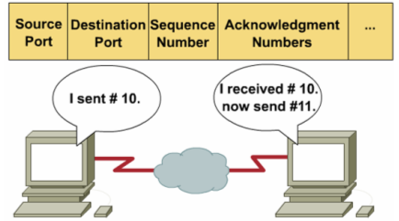
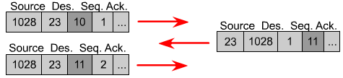
TCP: Sequence and acknowledgment

Slide 12
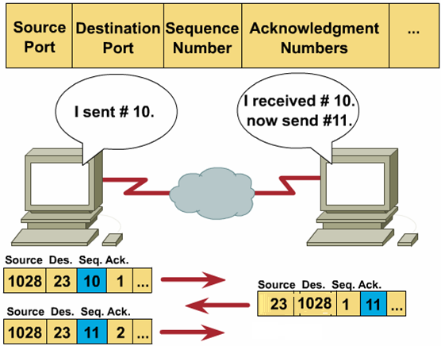
TCP: Sequence and acknowledgment
Notes:
TCP provides sequencing of segments with a forward reference acknowledgment. Each datagram is numbered before transmission. At the receiving station, TCP reassembles the segments into a complete message. If a sequence number is missing in the series, that segment is retransmitted. Segments that are not acknowledged within a given time period will result in a retransmission.

Slide 13
Transport Layer: TCP
TCP supplies a reliably transportation between end-user applications.
These are its characteristics:
  Connection-oriented.
  Supplies a virtual circuit between end-user applications
  Breacking outgoing messages into segments and reassembles messages at the destination.
  Resends anything not received by acknowledgement.
  Flow control: Windowing.
The protocols that use TCP include: FTP, HTTP SMTP, Telnet.
Notes:
Transmission Control Protocol (TCP) is a connection-oriented Layer 4 protocol that provides reliable full-duplex data transmission. TCP is part of the TCP/IP protocol stack. In a connection-oriented environment, a connection is established between both ends before the transfer of information can begin. TCP is responsible for breaking messages into segments, reassembling them at the destination station, resending anything that is not received, and reassembling messages from the segments. TCP.

Slide 14
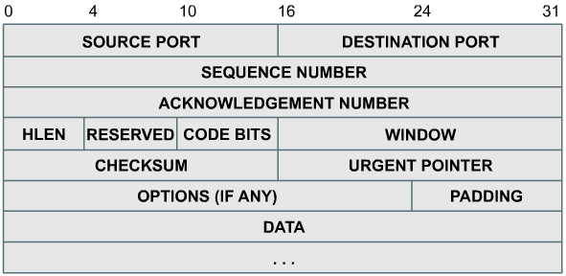
TCP Header format
RFC-761

Slide 15
TCP Header format: Port number
Source Port 16 bits.
Destination Port 16 bits.

Slide 16
TCP Header format: Sequence
Sequence Number: 32 bits
  The sequence number of the first data octet in this segment (except when SYN is present).

Slide 17
TCP Header format: Acknowledgment
Acknowledgment Number: 32 bits
  This field contains the value of the next sequence number the sender of the segment is expecting to receive.

Slide 18
TCP Header format: Code bits
Control Bits: 8 bits
  ACK: Acknowledgment field significant
  RST: Reset the connection
  SYN: Synchronize sequence numbers
  FIN: No more data from sender

Slide 19
TCP Header format: Window
Window: 16 bits
  The number of data octets beginning with the one indicated in the acknowledgment field which the sender of this segment is willing to accept.

Slide 20
Transport Layer: UDP
UDP transports data unreliably between hosts. Following are the characteristics:
  Connectionless.
  Unreliable, no software checking for message delivery
  Transmit messages, does not need reassemble incoming messages.
  Without acknowledgements.
  Error processing and retransmission must be handled by higher layer protocols.
The protocols that use UDP include: TFTP, SNMP , DHCP ,DNS .
Notes:
User Datagram Protocol (UDP) is the connectionless transport protocol in the TCP/IP protocol stack. UDP is a simple protocol that exchanges datagrams, without acknowledgments or guaranteed delivery. Error processing and retransmission must be handled by higher layer protocols. UDP uses no windowing or acknowledgments so reliability, if needed, is provided by application layer protocols. UDP is designed for applications that do not need to put sequences of segments together.

Slide 21
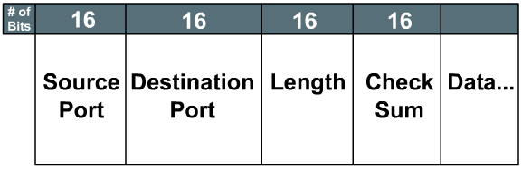
UDP Header format
RFC-768
UDP is a simple protocol that exchanges datagrams, without acknowledgments or guaranteed delivery.

Slide 22
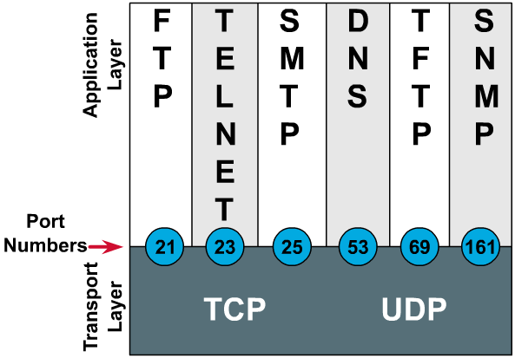
TCP and UDP port numbers
RFC-1700
Both TCP and UDP use port (or socket) numbers to pass information to the upper layers.
Notes:
Both TCP and UDP use port (socket) numbers to pass information to the upper layers. Port numbers are used to keep track of different conversations crossing the network at the same time.

Slide 23
Range of ports
2 bytes: 0 – 65535.
  Numbers below 255 : for public applications.
  Numbers from 255 - 1023 : assigned to companies for marketable applications.
  Numbers above 1023 : are unregulated.
End systems use port numbers to select proper applications.
Originating source port numbers are dynamically assigned by the source host; usually, it is a number larger than 1023.
Notes:
Application software developers agree to use well-known port numbers that are issued by the Internet Assigned Numbers Authority (IANA). Any conversation bound for the FTP application uses the standard port numbers 20 and 21. Port 20 is used for the data portion and port 21 is used for control. Conversations that do not involve an application with a well-known port number are assigned port numbers randomly from within a specific range above 1023. Some ports are reserved in both TCP and UDP, but applications might not be written to support them. Port numbers have the following assigned ranges:
Numbers below 1024 are considered well-known ports numbers.
Numbers above 1024 are dynamically assigned ports numbers.
Registered port numbers are those registered for vendor-specific applications. Most of these are above 1024.
End systems use port numbers to select the proper application. The source host dynamically assigns originating source port numbers. These numbers are always greater than 1023.

Slide 24
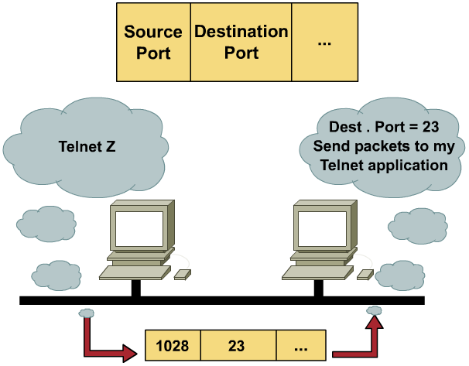
Telnet port number
Notes:
End systems use port numbers to select the proper application. The source host dynamically assigns originating source port numbers. These numbers are always greater than 1023.

Slide 25

TCP/IP APPLICATIONS

Slide 26
TCP Application layer protocols
Domain Name System (DNS)
File Transfer Protocol (FTP)
Hypertext Transfer Protocol (HTTP)
Simple Mail Transfer Protocol (SMTP)
Simple Network Management Protocol (SNMP)
Telnet
…
Notes:
When the TCP/IP model was designed, the session and presentation layers from the OSI model were bundled into the application layer of the TCP model. This means that issues of representation, encoding, and dialog control are handled in the application layer rather than in separate lower layers as in the OSI model. This design assures that the TCP/IP model provides maximum flexibility at the application layer for developers of software. The TCP/IP protocols that support file transfer, e-mail, and remote login are probably the most familiar to users of the Internet. These protocols include the following applications:
Domain Name System (DNS)
File Transfer Protocol (FTP)
Hypertext Transfer Protocol (HTTP)
Simple Mail Transfer Protocol (SMTP)
Simple Network Management Protocol (SNMP)
Telnet

Slide 27
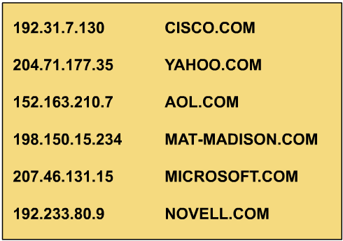
DNS: Problems with using IP address

Slide 28
DNS
The DNS server is a device on a network that manages domain names and responds to requests from clients to translate a domain name into the associated IP address.
The DNS system is set up in a hierarchy that creates different levels of DNS servers.
Notes:
The Internet is built on a hierarchical addressing scheme. This scheme allows for routing to be based on classes of addresses rather than based on individual addresses. The problem this creates for the user is associating the correct address with the Internet site. It is very easy to forget an IP address to a particular site because there is nothing to associate the contents of the site with the address. Imagine the difficulty of remembering the IP addresses of tens, hundreds, or even thousands of Internet sites. A domain naming system was developed in order to associate the contents of the site with the address of that site. The Domain Name System (DNS) is a system used on the Internet for translating names of domains and their publicly advertised network nodes into IP addresses. A domain is a group of computers that are associated by their geographical location or their business type. A domain name is a string of characters, number, or both. Usually a name or abbreviation that represents the numeric address of an Internet site will make up the domain name. There are more than 200 top-level domains on the Internet, examples of which include the following:
.us – United States
.uk – United Kingdom
There are also generic names, which examples include the following:
.edu – educational sites
.com – commercial sites
.gov – government sites
.org – non-profit sites
.net – network service

Slide 29
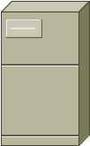
DNS: System
.
com
edu
gov
vn
fr
uk
vnn
com
edu
gov

Slide 30
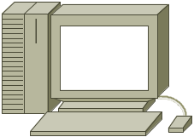
DNS: Database
63.63.0.1
.
203.162.0.1
vn
203.162.4.10
com
ctt – 203.162.50.1
aaa – 203.162.70.201
bbb – 203.160.9.7
203.162.50.1
ctt
www
www – 203.162.50.100
mail – 203.162.50.101
Lab – 203.160.100.1
www.ctt.com.vn
203.162.50.100

Slide 31
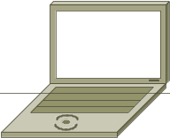
DNS: Resolve www.yahoo.com
Request
.
Reply
vn
com
Address of com server
Address of yahoo.com server
vnn
yahoo
Address of
www.yahoo.com
Address of www.yahoo.com

Slide 32
FTP and TFTP
FTP and TFTP are designed to download files or upload files on the Internet.
FTP is a reliable, connection-oriented service that use TCP. The FTP session is maintained until the client terminates it, or there is some sort of communication error.
TFTP is a connectionless sevice that use UDP
Notes:
FTP is a reliable, connection-oriented service that uses TCP to transfer files between systems that support FTP. The main purpose of FTP is to transfer files from one computer to another by copying and moving files from servers to clients, and from clients to servers. When files are copied from a server, FTP first establishes a control connection between the client and the server. Then a second connection is established, which is a link between the computers through which the data is transferred. Data transfer can occur in ASCII mode or in binary mode. These modes determine the encoding used for data file, which in the OSI model is a presentation layer task. After the file transfer has ended, the data connection terminates automatically. When the entire session of copying and moving files is complete, the command link is closed when the user logs off and ends the session.
TFTP is a connectionless service that uses User Datagram Protocol (UDP). TFTP is used on the router to transfer configuration files and Cisco IOS images and to transfer files between systems that support TFTP. TFTP is designed to be small and easy to implement. Therefore, it lacks most of the features of FTP. TFTP can read, write, or mail files to or from a remote server but it cannot list directories and currently has no provisions for user authentication. It is useful in some LANs because it operates faster than FTP and in a stable environment it works reliably.

Slide 33
HTTP
Web pages are created with a format language called Hypertext Markup Language (HTML).
Hyperlinks make the World Wide Web easy to navigate. A hyperlink is an object on a Web page that, when clicked, transfers you to a new Web page.
An address location known as a Uniform Resource Locator (URL).
Exsample: http://www.cisco.com/edu
Notes:
Hypertext Transfer Protocol (HTTP) works with the World Wide Web, which is the fastest growing and most used part of the Internet. One of the main reasons for the extraordinary growth of the Web is the ease with which it allows access to information. A Web browser is a client-server application, which means that it requires both a client and a server component in order to function. A Web browser presents data in multimedia formats on Web pages that use text, graphics, sound, and video. The Web pages are created with a format language called Hypertext Markup Language (HTML). HTML directs a Web browser on a particular Web page to produce the appearance of the page in a specific manner. In addition, HTML specifies locations for the placement of text, files, and objects that are to be transferred from the Web server to the Web browser. Hyperlinks make the World Wide Web easy to navigate. A hyperlink is an object, word, phrase, or picture, on a Web page. When that hyperlink is clicked, it directs the browser to a new Web page. The Web page contains, often hidden within its HTML description, an address location known as a Uniform Resource Locator (URL).
In the URL the "http://" tells the browser which protocol to use. The second part, "www", is the hostname or name of a specific machine with a specific IP address. The last part, /education identifies the specific folder location on the server that contains the default web page.

Slide 34
SMTP
Email servers communicate with each other using the SMTP to send and receive mail.
Email client, work with the POP3 or IMAP4 protocol to access email server.
Email client, work with the SMTP to send mail.
For security, when message recipients check their e-mail they are often prompted for a password. The password can also be saved in many e-mail programs.
An e-mail address consists of the recipient’s username and post-office address: ctt@yahoo.com.
Notes:
Email servers communicate with each other using the Simple Mail Transfer Protocol (SMTP) to send and receive mail. The SMTP protocol transports email messages in ASCII format using TCP. When a mail server receives a message destined for a local client, it stores that message and waits for the client to collect the mail. There are several ways for mail clients to collect their mail. They can use programs that access the mail server files directly or collect their mail using one of many network protocols. The most popular mail client protocols are POP3 and IMAP4, which both use TCP to transport data. Even though mail clients use these special protocols to collect mail, they almost always use SMTP to send mail. Since two different protocols, and possibly two different servers, are used to send and receive mail, it is possible that mail clients can perform one task and not the other. Therefore, it is usually a good idea to troubleshoot e-mail sending problems separately from e-mail receiving problems.
When checking the configuration of a mail client, verify that the SMTP and POP or IMAP settings are correctly configured. A good way to test if a mail server is reachable is to Telnet to the SMTP port (25) or to the POP3 port (110). The following command format is used at the Windows command line to test the ability to reach the SMTP service on the mail server at IP address 192.168.10.5: C:\>telnet 192.168.10.5 25
The SMTP protocol does not offer much in the way of security and does not require any authentication. Administrators often do not allow hosts that are not part of their network to use their SMTP server to send or relay mail. This is to prevent unauthorized users from using their servers as mail relays.

Slide 35
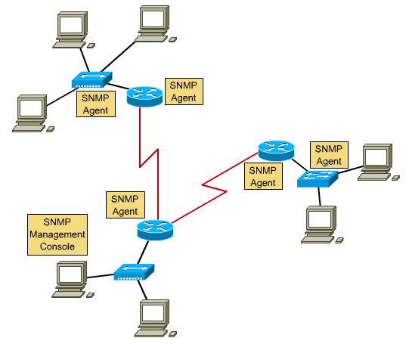
SNMP
Notes:
The Simple Network Management Protocol (SNMP) is an application layer protocol that facilitates the exchange of management information between network devices. SNMP enables network administrators to manage network performance, find and solve network problems, and plan for network growth. SNMP uses UDP as its transport layer protocol.

Slide 36
SNMP
SNMP enables network administrators to manage network performance, find and solve network problems, and plan for network growth.
SNMP uses UDP as its transport layer protocol.
Three key components:
  Network management system (NMS)
  Managed devices
  Agents
Notes:
The Simple Network Management Protocol (SNMP) is an application layer protocol that facilitates the exchange of management information between network devices. An SNMP managed network consists of the following three key components:
Network management system (NMS) – NMS executes applications that monitor and control managed devices. The bulk of the processing and memory resources required for network management are provided by NMS. One or more NMSs must exist on any managed network.
Managed devices – Managed devices are network nodes that contain an SNMP agent and that reside on a managed network. Managed devices collect and store management information and make this information available to NMSs using SNMP. Managed devices, sometimes called network elements, can be routers, access servers, switches, and bridges, hubs, computer hosts, or printers.
Agents – Agents are network-management software modules that reside in managed devices. An agent has local knowledge of management information and translates that information into a form compatible with SNMP.

Slide 37
Telnet
Telnet software provides the ability to remotely access another computer.
The Telnet application works mainly at the application, presentation and session layers of the OSI model.
Notes:
Telnet client software provides the ability to login to a remote Internet host that is running a Telnet server application and then to execute commands from the command line. A Telnet client is referred to as a local host. Telnet server, which uses special software called a daemon, is referred to as a remote host.
To make a connection from a Telnet client, the connection option must be selected. A dialog box typically prompts for a host name and terminal type. The host name is the IP address or DNS name of the remote computer. The terminal type describes the type of terminal emulation that the Telnet client should perform. The Telnet operation uses none of the processing power from the transmitting computer. Instead, it transmits the keystrokes to the remote host and sends the resulting screen output back to the local monitor. All processing and storage take place on the remote computer.
Telnet works at the application layer of the TCP/IP model. Therefore, Telnet works at the top three layers of the OSI model. The application layer deals with commands. The presentation layer handles formatting, usually ASCII. The session layer transmits. In the TCP/IP model, all of these functions are considered to be part of the application layer.

Slide 38

Summary
The functions of the TCP/IP transport layer
  Flow control
  The processes of establishing a connection between peer systems
  Windowing
  Acknowledgment
Transport layer protocols
  TCP and UDP header formats
  TCP and UDP port numbers
The processes and protocols at the TCP/IP application layer
  Domain Name Services
  File Transfer Protocols
  Simple Mail Transfer Protocol
  Simple Network Management Protocol
  Telnet

Slide 39

Q&A
Notes:
_________________________________________________________________________
_________________________________________________________________________
_________________________________________________________________________
_________________________________________________________________________
_________________________________________________________________________
_________________________________________________________________________
_________________________________________________________________________
_________________________________________________________________________
_________________________________________________________________________
_________________________________________________________________________
_________________________________________________________________________
_________________________________________________________________________
_________________________________________________________________________
_________________________________________________________________________
_________________________________________________________________________
_________________________________________________________________________
_________________________________________________________________________
_________________________________________________________________________
_________________________________________________________________________

Slide 40
Enjoy the Course
Notes:
_________________________________________________________________________
_________________________________________________________________________
_________________________________________________________________________
_________________________________________________________________________
_________________________________________________________________________
_________________________________________________________________________
_________________________________________________________________________
_________________________________________________________________________
_________________________________________________________________________
_________________________________________________________________________
_________________________________________________________________________
_________________________________________________________________________
_________________________________________________________________________
_________________________________________________________________________
_________________________________________________________________________
_________________________________________________________________________
_________________________________________________________________________
_________________________________________________________________________
_________________________________________________________________________

